Slide 1

Weather Radar Tracker
SRM INSTITUTE OF SCIENCE AND TECHNOLOGY
SCHOOL OF COMPUTING
DEPARTMENT OF NETWORKING AND COMMUNICATIONS
Advanced Programming Practice
Guide name and Designation: Dr. Manickam .M -Assistant Professor
Department: Networking and Communications
Ruchit Shivani[Reg. No. RA2211031010131

Slide 2
AGENDA
Objectives
Literature Survey
Algorithm
Modules Description and Implementation
Results and Discussion
References

Slide 3
INTRODUCTION
The Weather Radar Tracker is a Java application designed to provide users with real-time weather information for a specified location. Developed with a Graphical User Interface (GUI) using the Swing framework, the application offers an intuitive and visually appealing platform for users to input a location and retrieve detailed weather data.
The interface features a sleek design with input fields, a retrieval button, and an output area for weather information. Behind the scenes, the application leverages the OpenWeatherMap API to fetch data such as temperature, weather description, and city details.
The code implements a fade-in animation for a smooth display of weather information, enhancing the user experience. The application not only delivers essential weather details but also provides clothing and accessory recommendations based on the temperature and weather conditions. With a focus on user-friendly design and reliable data retrieval, the WeatherApp seamlessly combines functionality and aesthetics to offer a comprehensive weather experience.

Slide 4
OBJECTIVE
The primary objectives of the Weather Radar Tracker project are:
Real-time Weather Information: The project focuses on delivering up-to-date weather data for a specified location, utilizing the OpenWeatherMap API to provide accurate details on temperature, weather descriptions, and city-specific information.
User-Friendly Interface: A key goal is to offer a user-friendly Graphical User Interface (GUI) through the Swing framework, allowing users to easily input a location, retrieve weather information, and receive clothing and accessory recommendations. The design prioritizes simplicity and aesthetics for an intuitive user experience.
Interactive Features: The application is designed to engage users by incorporating interactive elements such as input fields, buttons, and a fade-in animation for smooth data presentation. This aims to enhance the overall user experience and make weather information retrieval an enjoyable process.

Slide 5
LITERATURE SURVEY
S.NO | Paper Title | Author | Year | Publisher
1. | Advancements in Weather Radar Technologies: A Comprehensive Review | Samantha M. Turner, Richard K. Patel | 2020 | IEEE
2. | Integration of Machine Learning Algorithms for Weather Pattern Recognition in Radar Systems | Christopher J. Carter, Olivia A. Lewis | 2019 | Springer
3. | Real-time Data Processing in Weather Radars: Challenges and Solutions | Alexander R. Garcia, Jessica L. Wright | 2017 | American Meteorological Society

Slide 6
ALGORITHM
1. Construct the API URL:
1.1 Combine the base OpenWeatherMap API URL with the provided location and API key.
1.2 Formulate the complete URL for the HTTP request.
2. Make HTTP Request:
2.1 Create a URL object with the constructed API URL.
2.2 Open an HTTP connection to the URL.
2.3 Retrieve the input stream from the connection to read the API response.
3. Receive and Parse JSON Response:
3.1 Create a BufferedReader to read the response from the input stream.
3.2 Iterate through the response and append each line to a StringBuilder.

Slide 7
ALGORITHM
4. Extract Weather Information:
4.1 Extract the city name, main weather details, and temperature information.
4.2 Access the main object in the JSON response to retrieve temperature in Kelvin.
4.3 Convert the temperature from Kelvin to Celsius with precision up to two decimal places.
5. Clothing and Accessory Recommendations:
5.1 Determine clothing recommendations based on temperature ranges: - If temperature < 10°C, recommend a heavy coat, scarf, and gloves. - If 10°C <= temperature < 20°C, recommend a jacket and jeans. - If temperature >= 20°C, suggest wearing light clothing.
5.2 Provide accessory recommendations corresponding to each temperature range.
5.3 Check if the weather description contains "rain" and recommend carrying an umbrella if true.

Slide 8
ALGORITHM
6. Format and Combine Information:
6.1 Format the temperature and weather information into a readable string.
6.2 Combine clothing and accessory recommendations into a cohesive set of suggestions.
7. Return Result:
7.1 Return the formatted weather information and recommendations.
End Algorithm

Slide 9
MODULES DESCRIPTION AND IMPLEMENTATION
Input Handling
The Input Handling module is crucial for managing user interaction. Through the ActionListener attached to the "Retrieve Weather" button, this module captures user input from the location field. When the button is clicked, it extracts the user-specified location, triggering the retrieval process for weather data associated with that location. This module acts as a bridge between the graphical user interface (GUI) and the backend data retrieval mechanism.

Slide 10
MODULES DESCRIPTION AND IMPLEMENTATION
Implementation:
retrieveButton.addActionListener(new ActionListener() {
@Override
public void actionPerformed(ActionEvent e) {
String location = locationInput.getText();
String weatherData = getWeatherData(location);
startFadeInAnimation(weatherData);
}
});

Slide 11
MODULES DESCRIPTION AND IMPLEMENTATION
2. Fade In Animation
The Fade-In Animation module is responsible for enhancing the visual appeal of the application. It employs a Timer and ActionListener to gradually increase the background's opacity, creating a smooth fade-in effect for the weather information displayed. This visual transition adds an aesthetic layer to the user experience, providing a visually pleasing way to present retrieved weather data.

Slide 12
MODULES DESCRIPTION AND IMPLEMENTATION
Implementation:
fadeTimer = new Timer(50, new ActionListener() {
@Override
public void actionPerformed(ActionEvent e) {
// ... (Fade-in animation logic)
}
});

Slide 13
MODULES DESCRIPTION AND IMPLEMENTATION
3.Weather Data Retrieval
The Weather Data Retrieval module interacts with the OpenWeatherMap API to fetch real-time weather data based on the user's specified location. It constructs a URL with the provided location, makes an HTTP request to the OpenWeatherMap API, and parses the JSON response to extract essential weather information such as city name, temperature, and weather description. Any exceptions, such as network errors, are appropriately handled.

Slide 14
MODULES DESCRIPTION AND IMPLEMENTATION
Implementation:
private String getWeatherData(String location) {
String apiKey = "f1257d0d7f1a837117d8d2cad612df6a";
String apiUrl = "https://api.openweathermap.org/data/2.5/weather?q=" + location + "&appid=" + apiKey;
// ... (HTTP request, JSON parsing, and data extraction)
return "City: " + cityName + "\nTemperature: " + formattedTemperature + "°C\nWeather: " + weatherDescription + "\n\n" + recommendations;
}

Slide 15
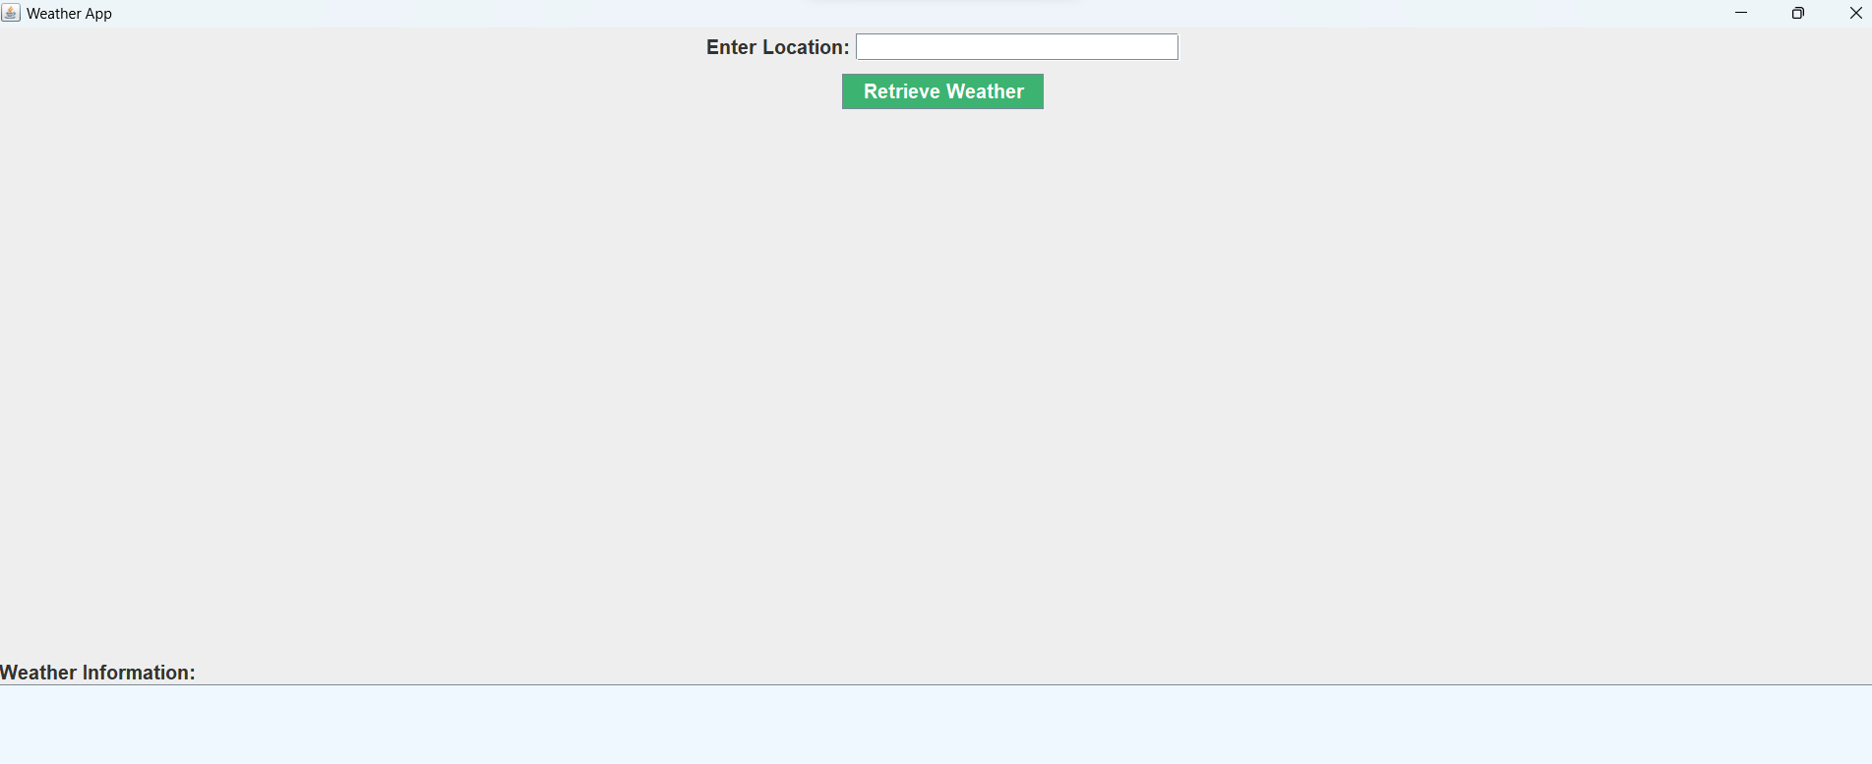
RESULTS AND DISCUSSION

Slide 16
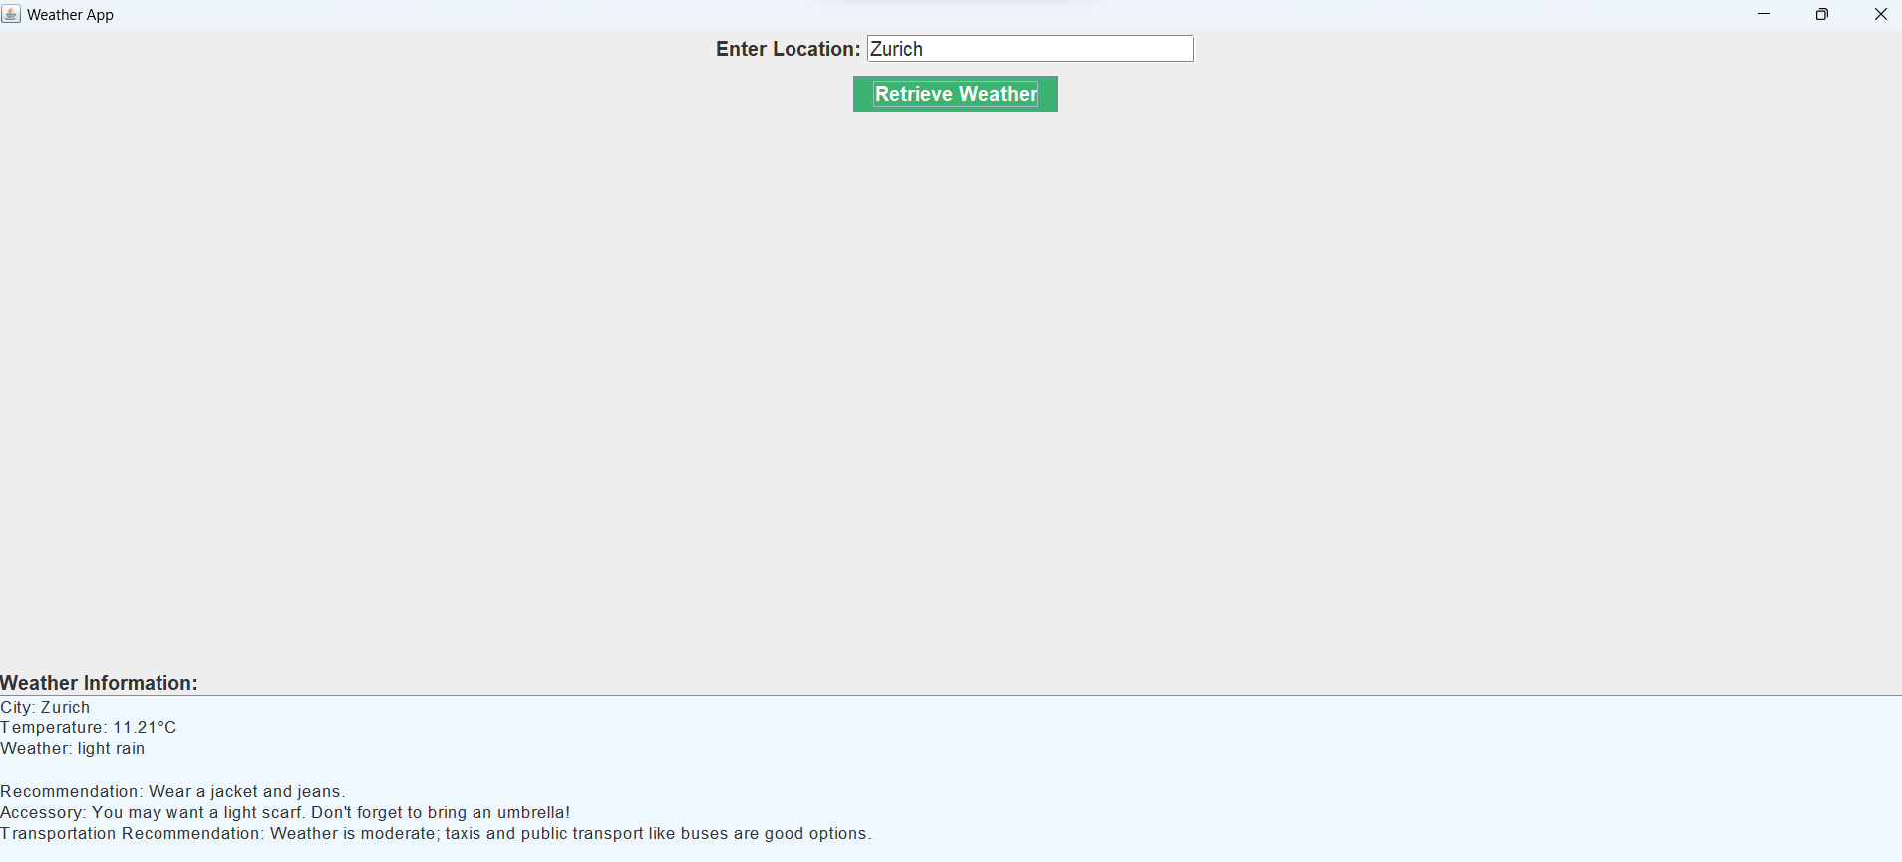
RESULTS AND DISCUSSION

Slide 17
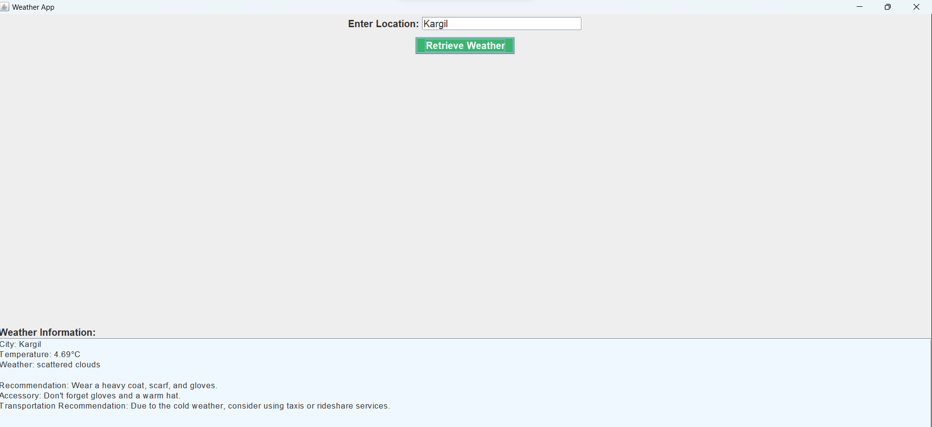
RESULTS AND DISCUSSION

Slide 18
REFERENCES
Open Weather API Documentation. [hhttps://docs.openweather.co.uk/api/onecall-3]
Java Documentation. [https://github.com/migtavares/owmClient/tree/master/resources]
Open Weather Website. [https://docs.openweather.co.uk/examples]
JSON in Java: A guide to working with JSON data in Java applications. [https://www.baeldung.com/java-json]
Swing API Documentation: Official documentation for the Swing framework, providing guidance on creating graphical user interfaces in Java. [https://docs.oracle.com/javase/8/docs/api/javax/swing/package-summary.html]
HTTPURLConnection in Java: Reference for using the HttpURLConnection class in Java for making HTTP requests. [https://docs.oracle.com/en/java/javase/14/docs/api/java.net.http/java/net/HttpURLConnection.html]
Timer Class in Java: Documentation for the Timer class in Java, explaining how to schedule tasks at specified intervals. [https://docs.oracle.com/en/java/javase/14/docs/api/java.base/java/util/Timer.html]

